Slide 1
DIGITAL SIGNAGE

Slide 2
GROUP MEMBERS:
BIT21208 Aleeza Aftab.
BIT21242 Ayesha Shahbaz.
ADVISER: Prof. Salmaan Naseer Adil

Slide 3
INTRODUCTION
A digital signage is an application that allows businesses to create, manage, and showcase promotions, advertisements, announcements and other relevant information of products visually on digital screens.
This can help explore the ways to use digital to inform, entertain, educate and communicate with customers in your store.Enable Customers to easily explore products through digital screens independently, get informed by new releases, sales and they can see all the detailed information of products by himself/herself instead of waiting in long lines for their turn.

Slide 4
OBJECTIVES & SCOPES
OBJECTIVES:
SCOPES:
Enable customers to see all details of products including features and prices.
In absence of a salesman,customers can explore products by themselves instead of waiting.
To reduce display costs and other costs.
Owners can maintain inventory records.
Customers can see availability and unavailability of products.
Dynamic content delivery
Remote control
Engagement boost
Smart-decision making
Cost savings.
Adaptability.
Easy setup.

Slide 5
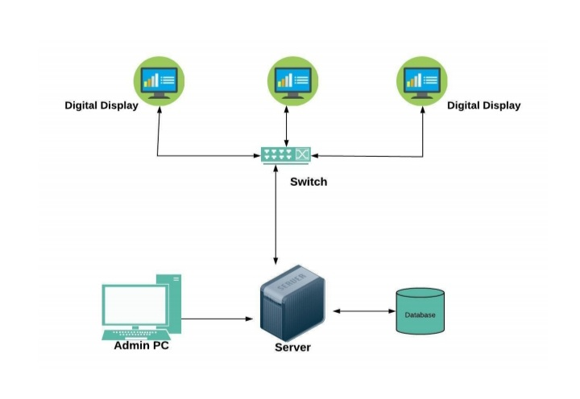
SYSTEM ARCHITECTURE AND DESIGN
Components:
•Admin: Manage content and inventory.
•User: Explore products.

Slide 6
TECHNOLOGIES & LANGUAGES
TOOLS
Frontend:
▪︎ Html
▪︎ CSS
▪︎ JavaScript
▪︎ Java
▪︎ Bootstrap
Backend:
▪︎ C#
▪︎ ASP.Net
▪︎ MySQL
Visual Studio
Xampp Server
MySQL for database

Slide 7
FEATURES
User-friendly interface.
Login.
View item/product by category or by search.
View all details of products.
Cart option.
Order product.
Update option.
Payment option.

Slide 8
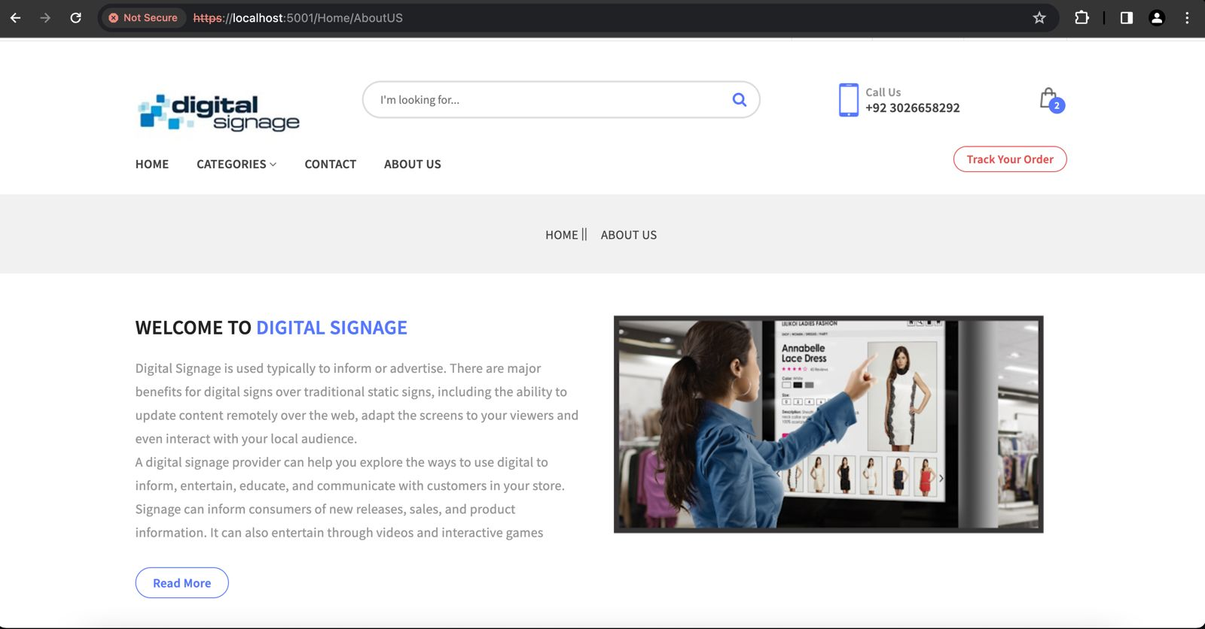
SYSTEM OVERVIEW

Slide 9
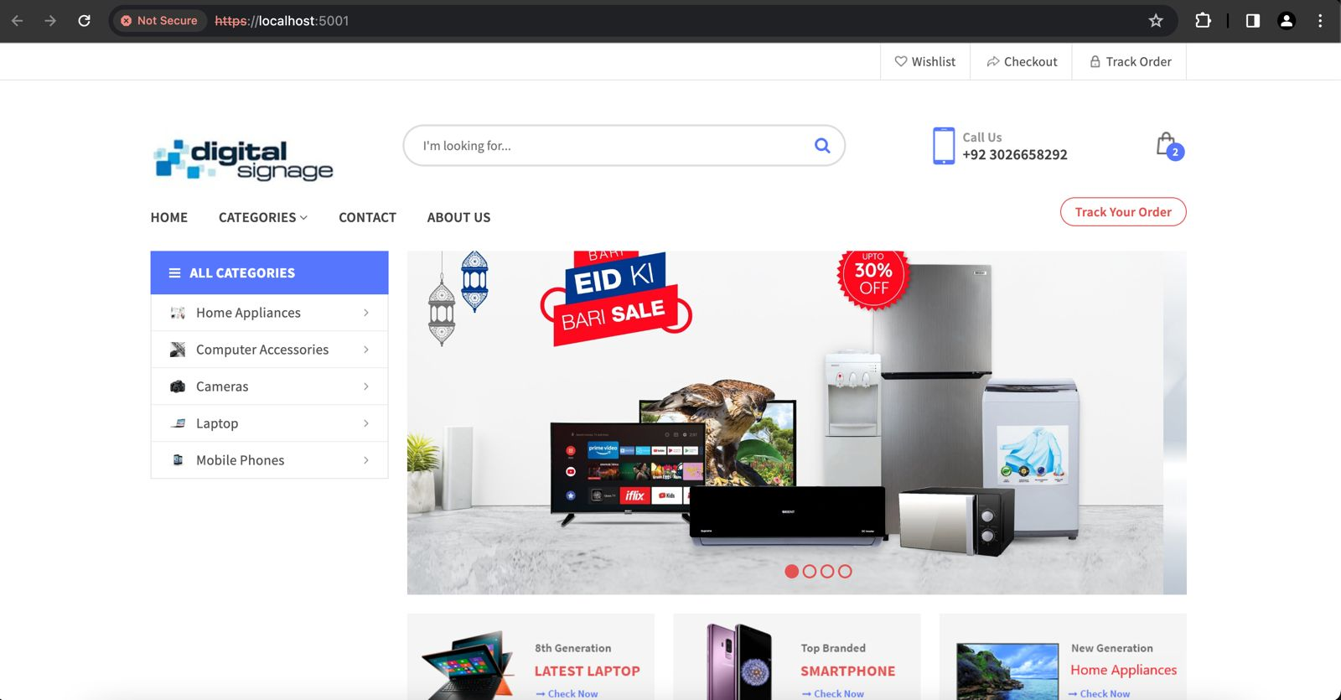
SYSTEM OVERVIEW

Slide 10
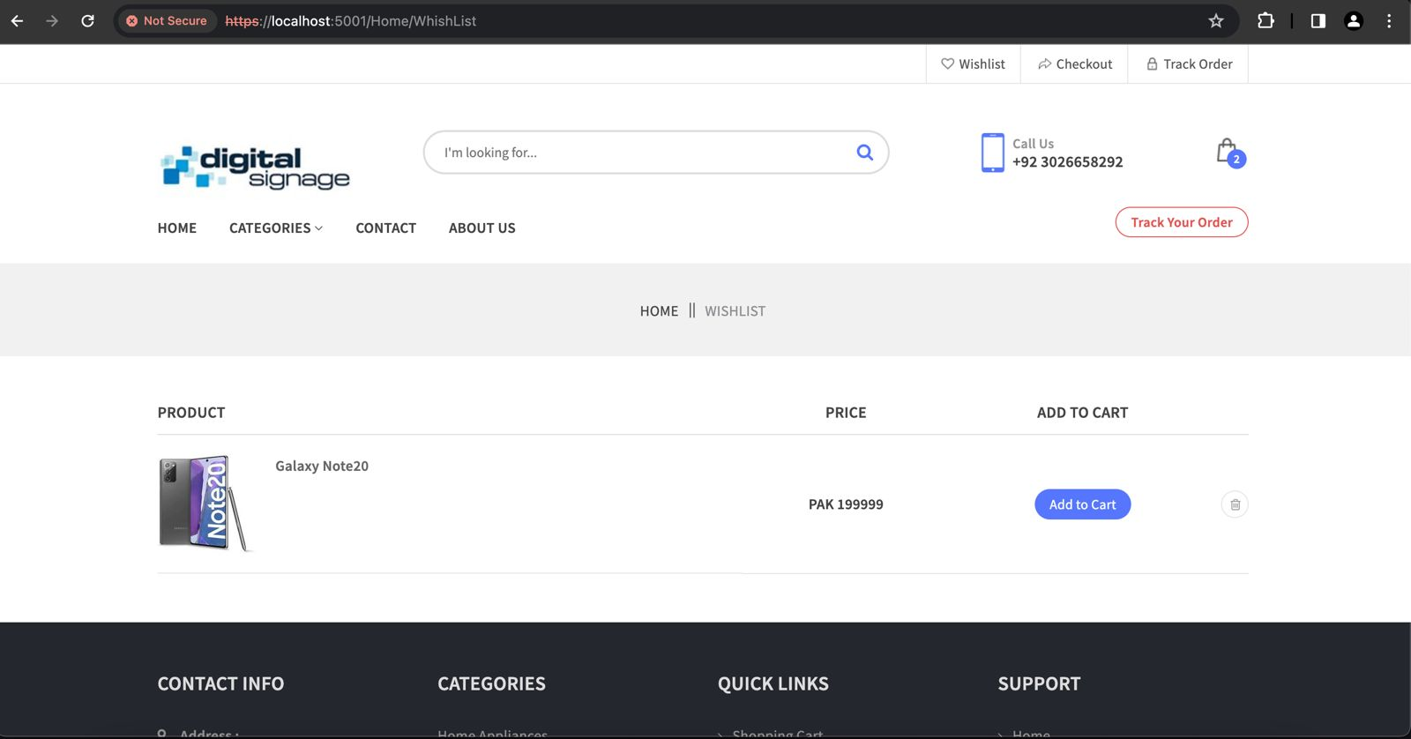
SYSTEM OVERVIEW

Slide 11
CONCLUSION
Successfully implemented a dynamic digital signage system enhancing user interaction and reducing costs.

Slide 12
THANK YOU...

